Slide 2
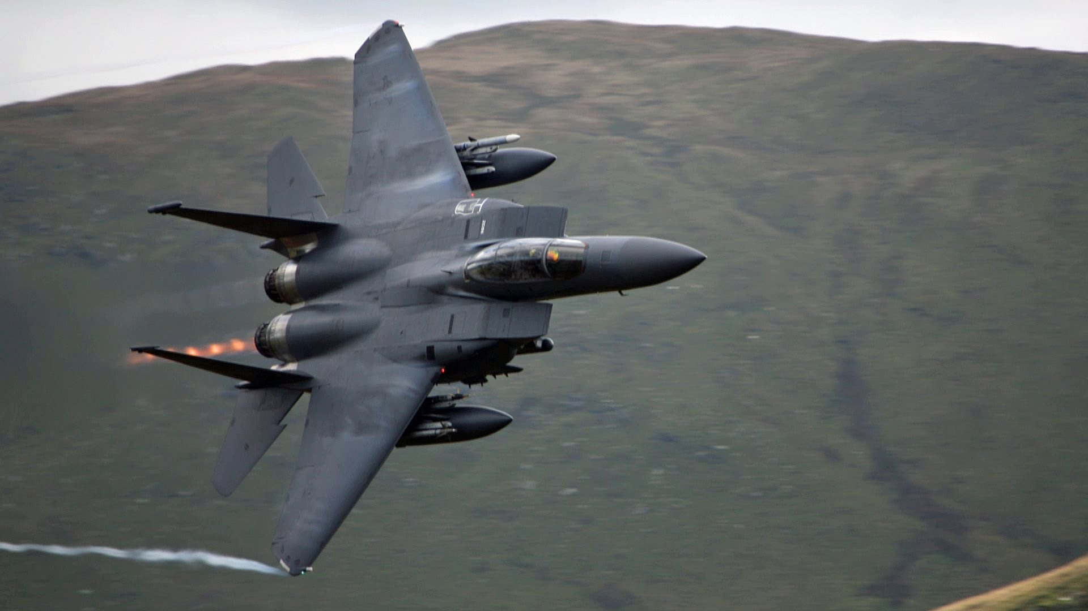
Source: Wonkabar007, youtube.com

Slide 3
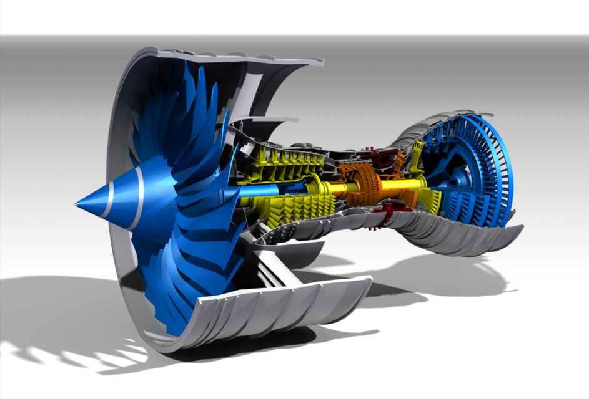
Source: grabcad.com

Slide 4
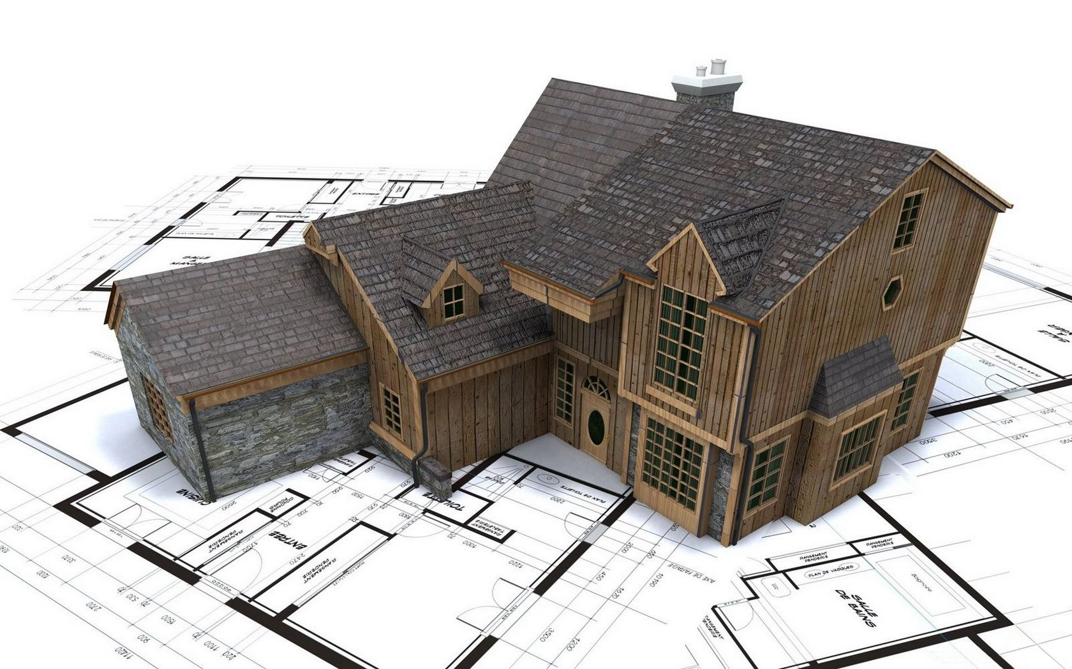
Source: wallpaperup.com

Slide 5
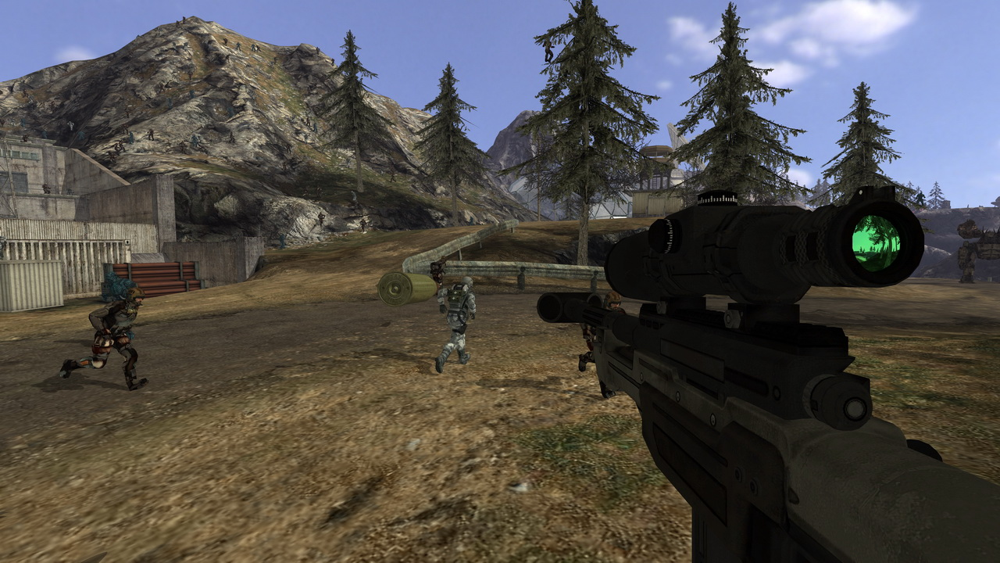
Source: Quake Wars: Ray Traced, Wikipedia

Slide 6
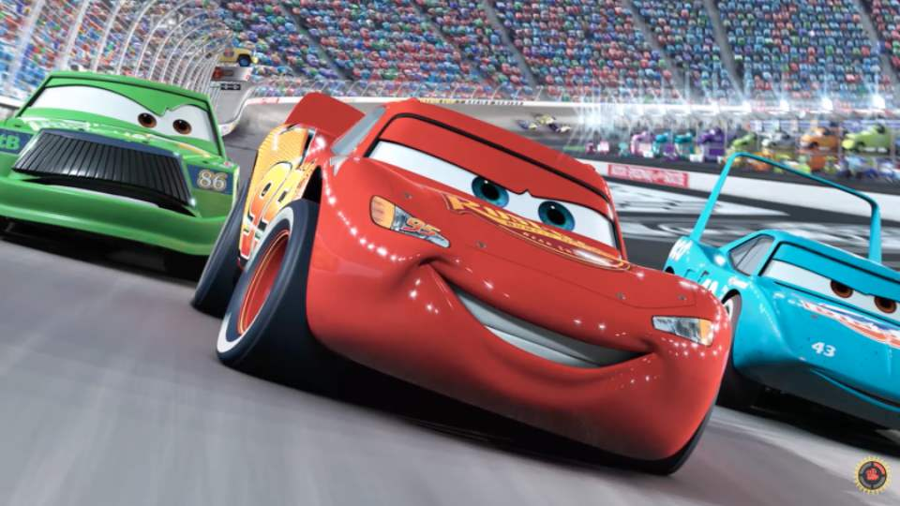
Source: Cars, Pixar, Wikipedia

Slide 7
Source: Quake Wars: Ray Traced, Wikipedia

Slide 8
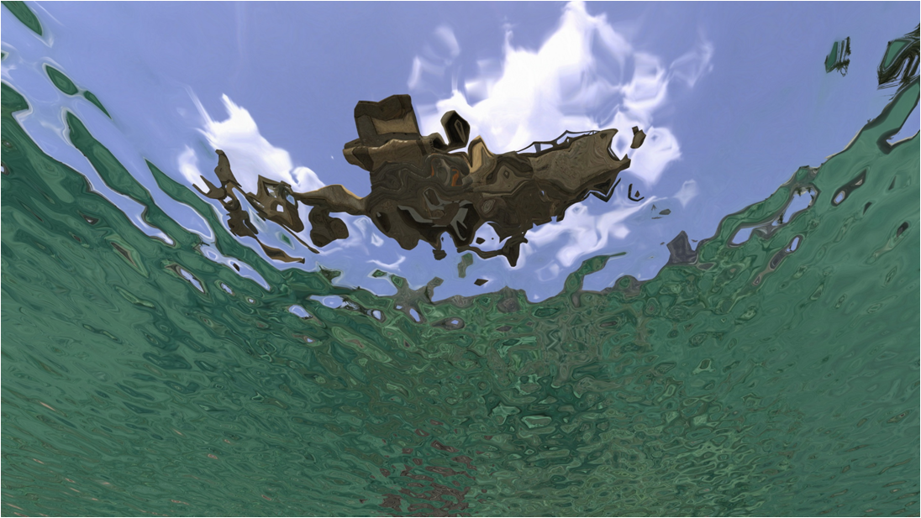
Source: Quake Wars: Ray Traced, Wikipedia

Slide 9
Source: Cars, Pixar, Wikipedia

Slide 10
Source: Cars, Pixar, Wikipedia

Slide 11
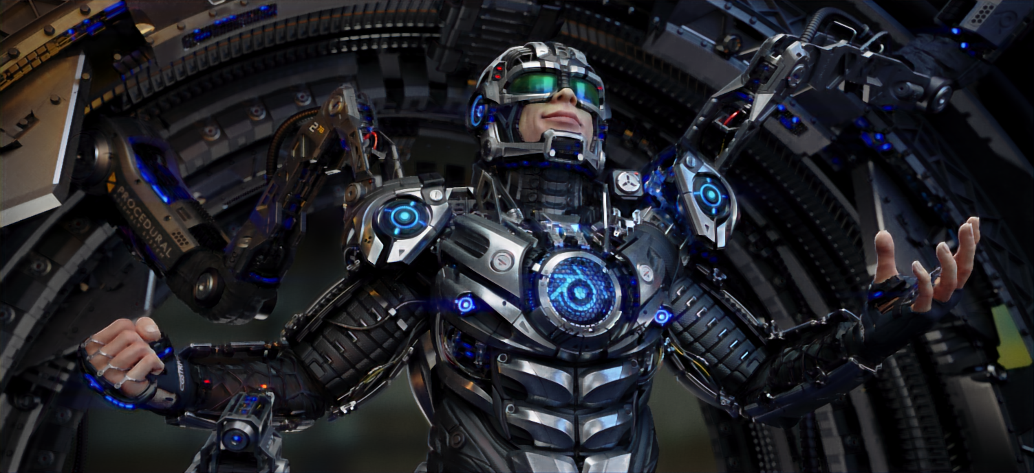
Source: Juri Unt (Artist), Zichen Liu (Renderer), airenderer.com

Slide 12
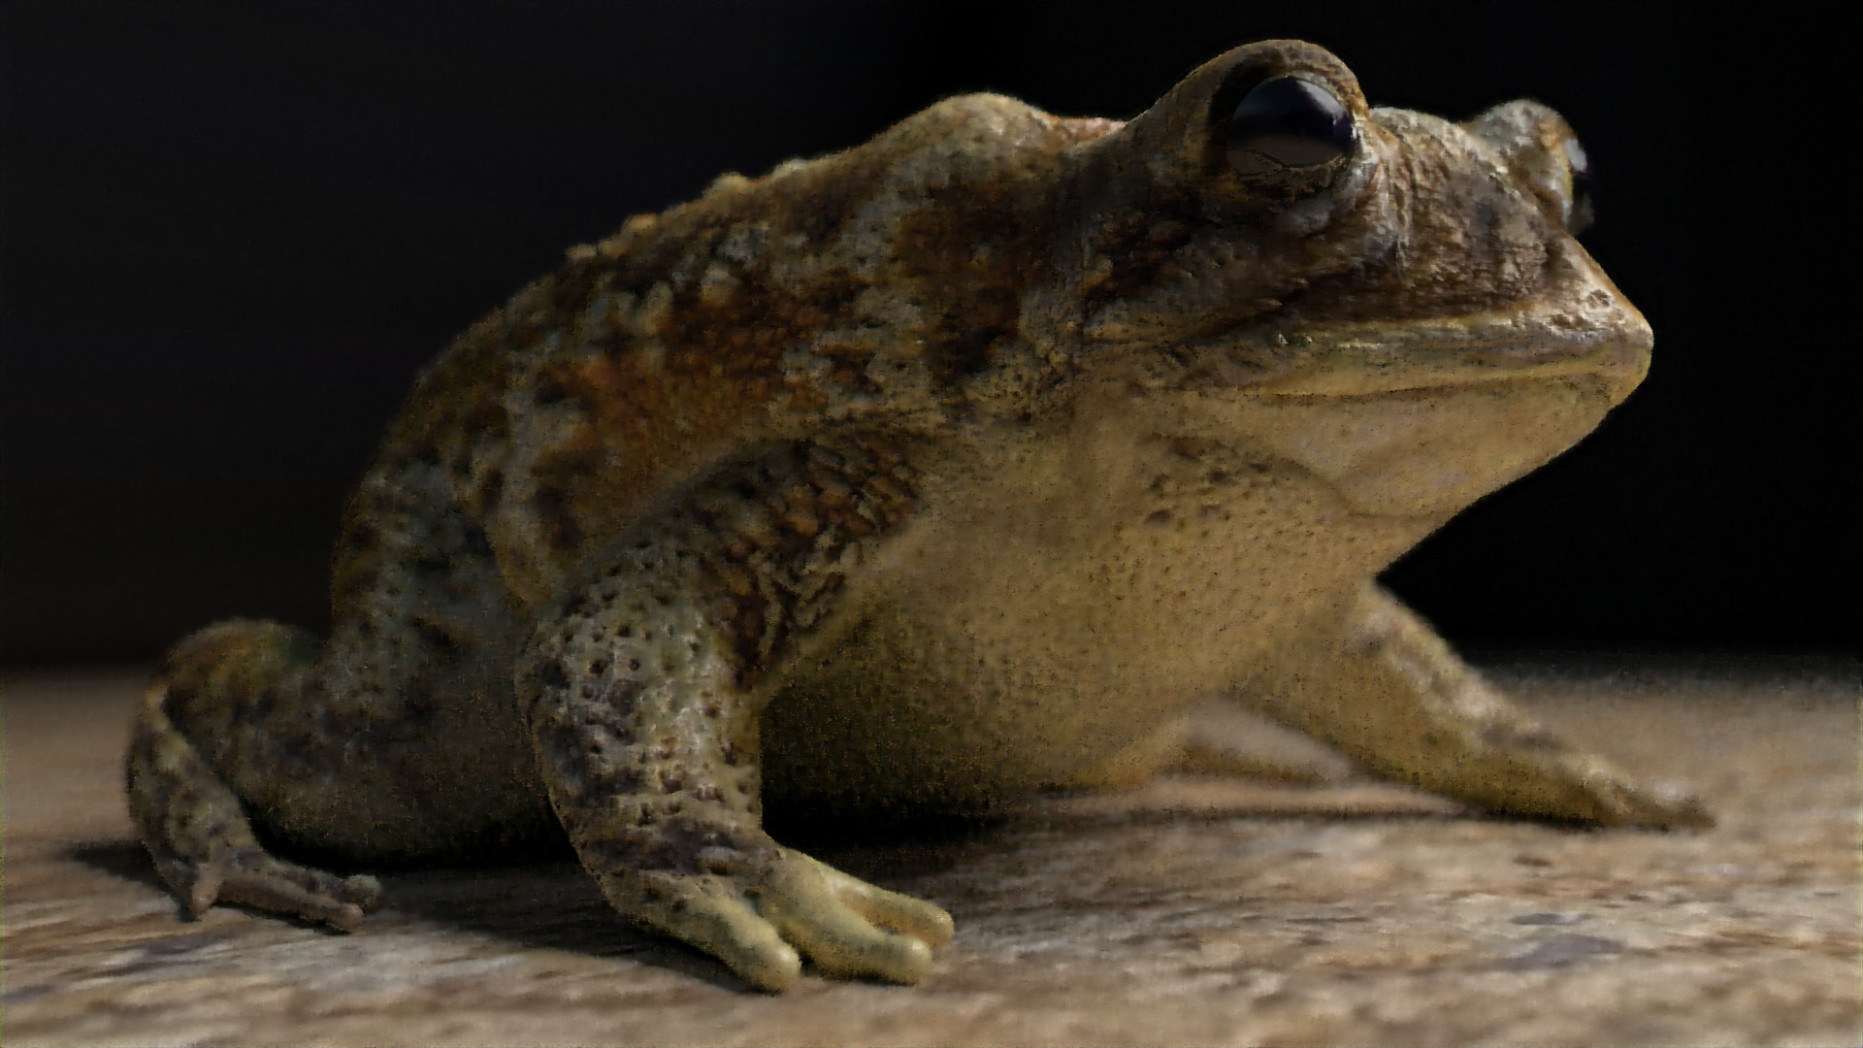
Source: arenyart (Artist), Zichen Liu (Renderer), airenderer.com

Slide 13
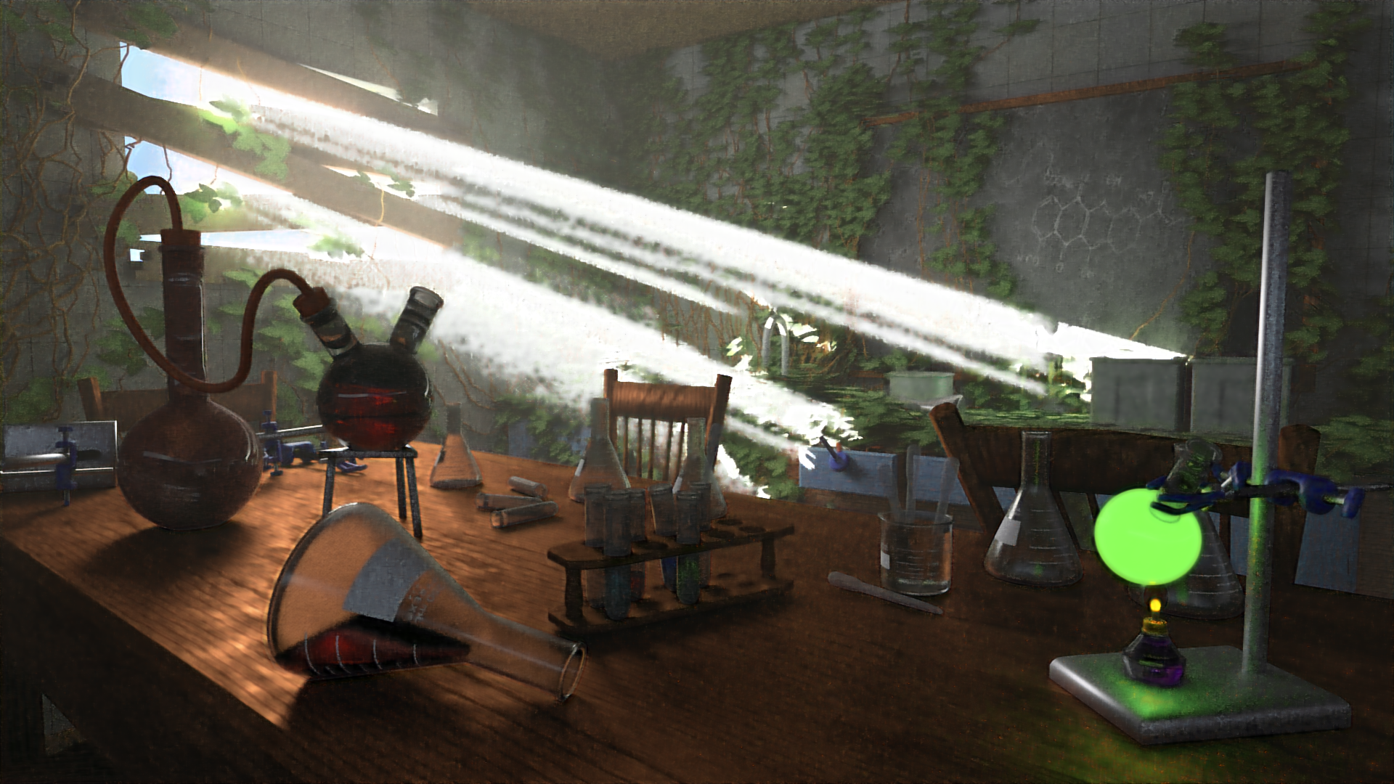
Source: Elysia (Artist), Zichen Liu (Renderer), airenderer.com

Slide 14
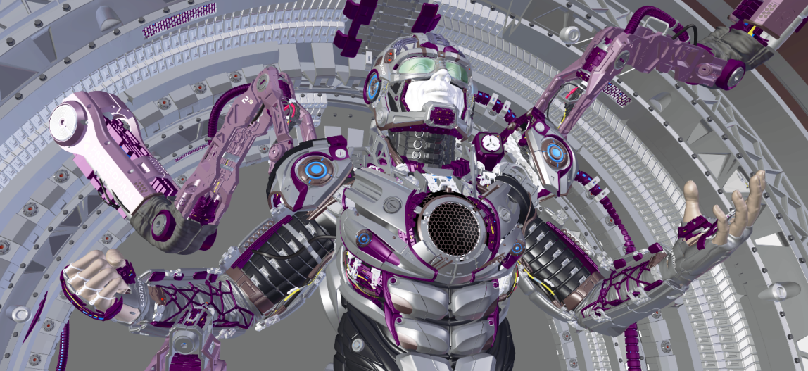
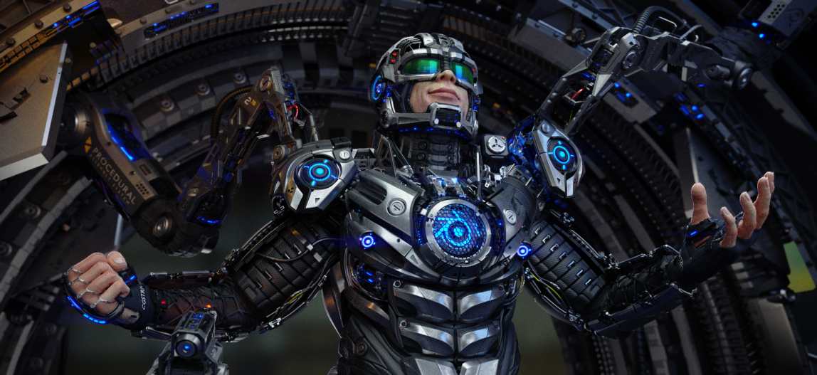
Source: Juri Unt (Artist), Zichen Liu (Renderer), airenderer.com

Slide 15
Spec
Ray tracer
Noisy Image
Ray tracer
Clean Image
Approx. 1 min
Approx. 1 hour

Slide 16
Ours
Approx. 2 mins
Spec
Ray tracer
Noisy Image
Ray tracer
Clean Image
Approx. 1 min
Approx. 1 hour

Slide 17

Source: Juri Unt (Artist), Zichen Liu (Renderer)

Slide 18
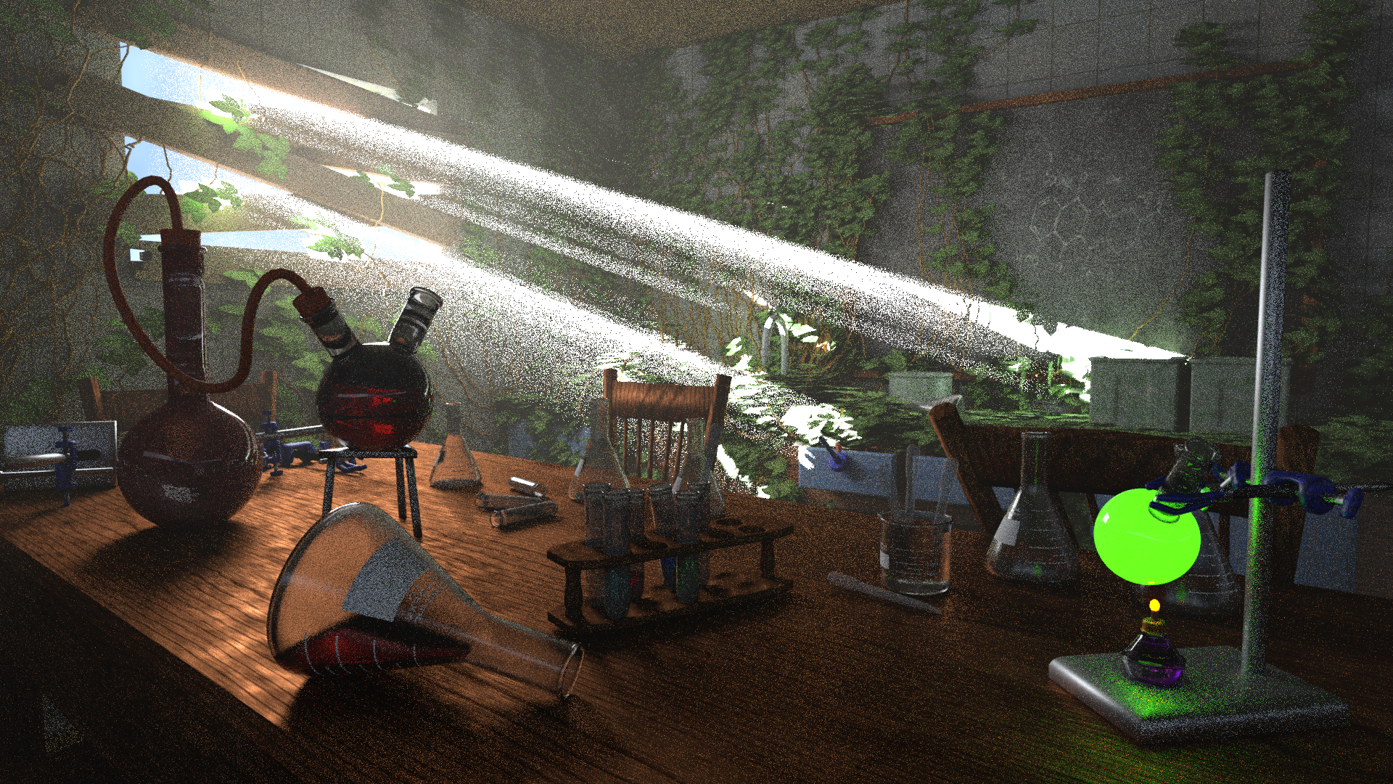
Source: Elysia (Artist), Zichen Liu (Renderer)

Slide 19
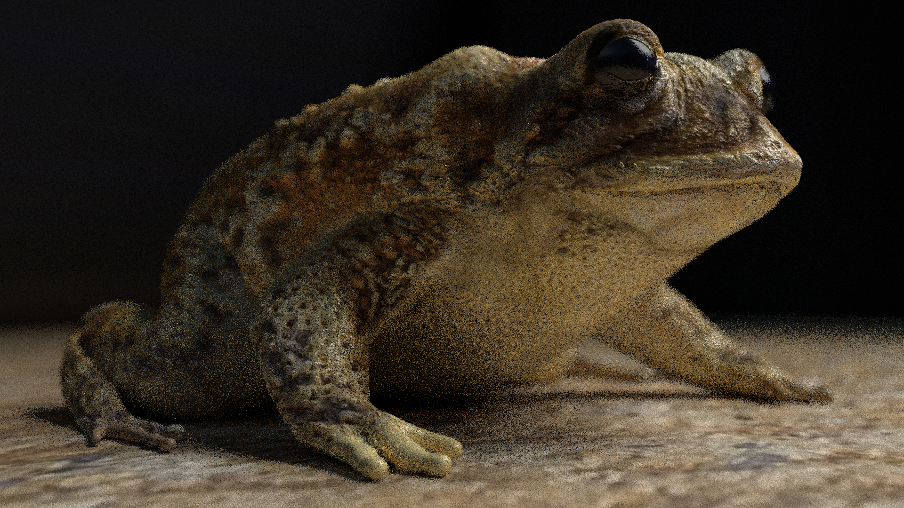
Source: arenyart (Artist), Zichen Liu (Renderer)

Slide 20
Source: Juri Unt (Artist), Zichen Liu (Renderer), airenderer.com

Slide 21
Noisy
Ours
Source: Juri Unt (Artist), Zichen Liu (Renderer)

Slide 22

Ray traced
Ours
Source: Juri Unt (Artist), Zichen Liu (Renderer)

Slide 23
Ours
Spec
Ray tracer
Noisy Image
Ray tracer
Clean Image
Ray tracer
40 minutes
Ours
2 minutes

Slide 24
Source: arenyart (Artist), Zichen Liu (Renderer), airenderer.com

Slide 25
Source: arenyart (Artist), Zichen Liu (Renderer)

Slide 26
Ours
Spec
Ray tracer
Noisy Image
Ray tracer
Clean Image
Ray tracer
14 minutes
Ours
2 minutes

Slide 27
Source: Elysia (Artist), Zichen Liu (Renderer), airenderer.com

Slide 28
Source: Elysia (Artist), Zichen Liu (Renderer)

Slide 29
Ours
Spec
Ray tracer
Noisy Image
Ray tracer
Clean Image
Ray tracer
120 + ? minutes
Ours
2 minutes

Slide 30
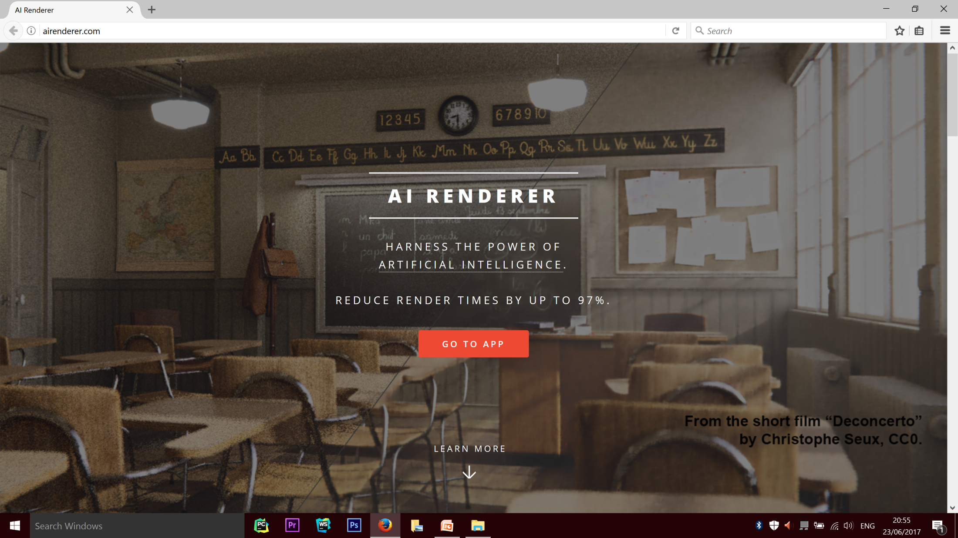

Slide 31
1000+
visits

Slide 32
108
app uses

Slide 33
26
ratings left

Slide 34
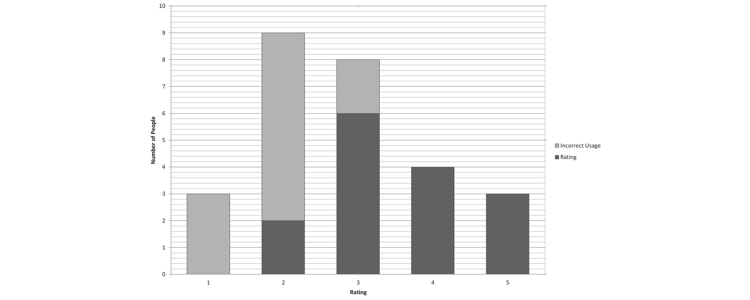

Slide 36
50 million
training examples
30 million
test examples
150+
models tested

Slide 37
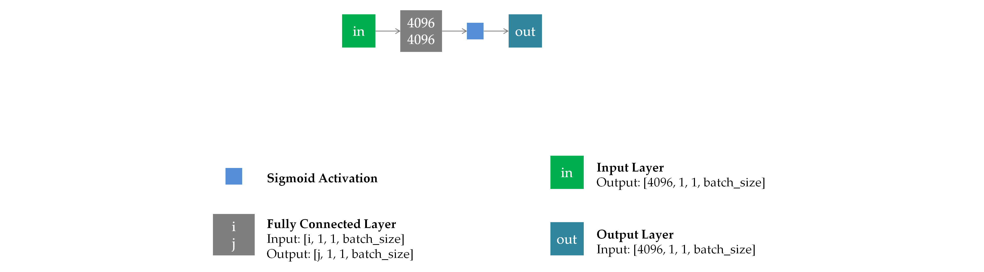

Slide 38
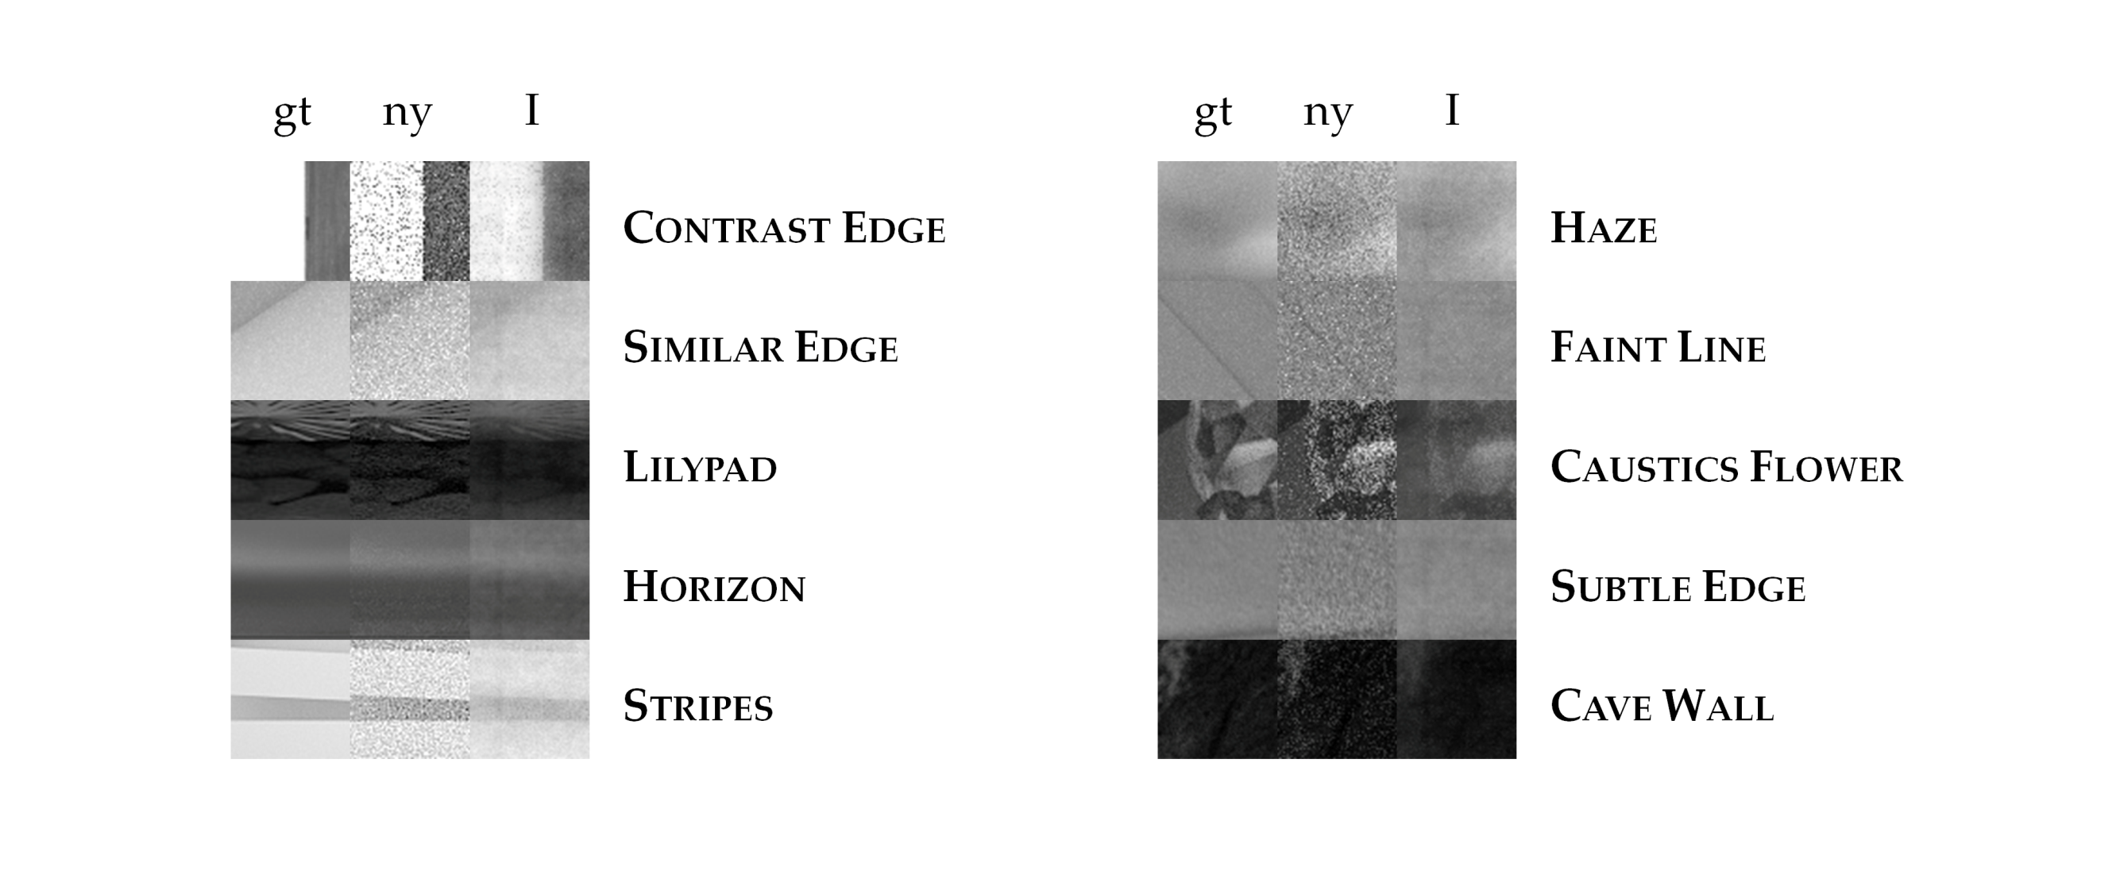

Slide 39
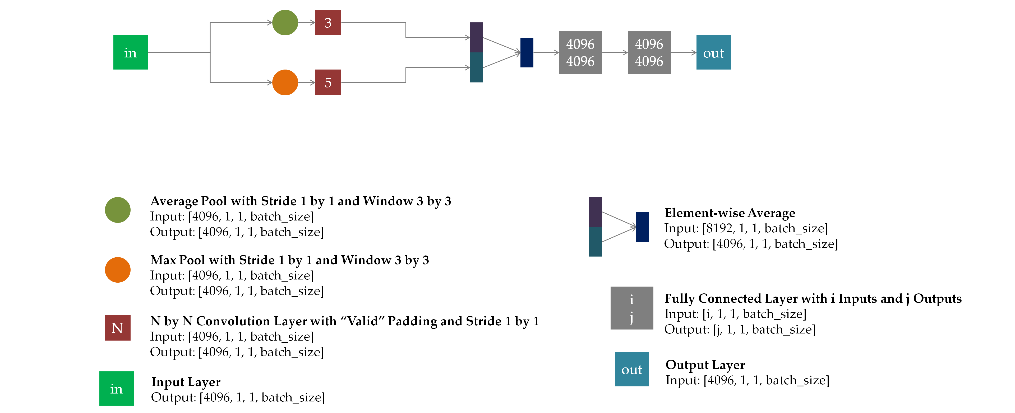

Slide 40
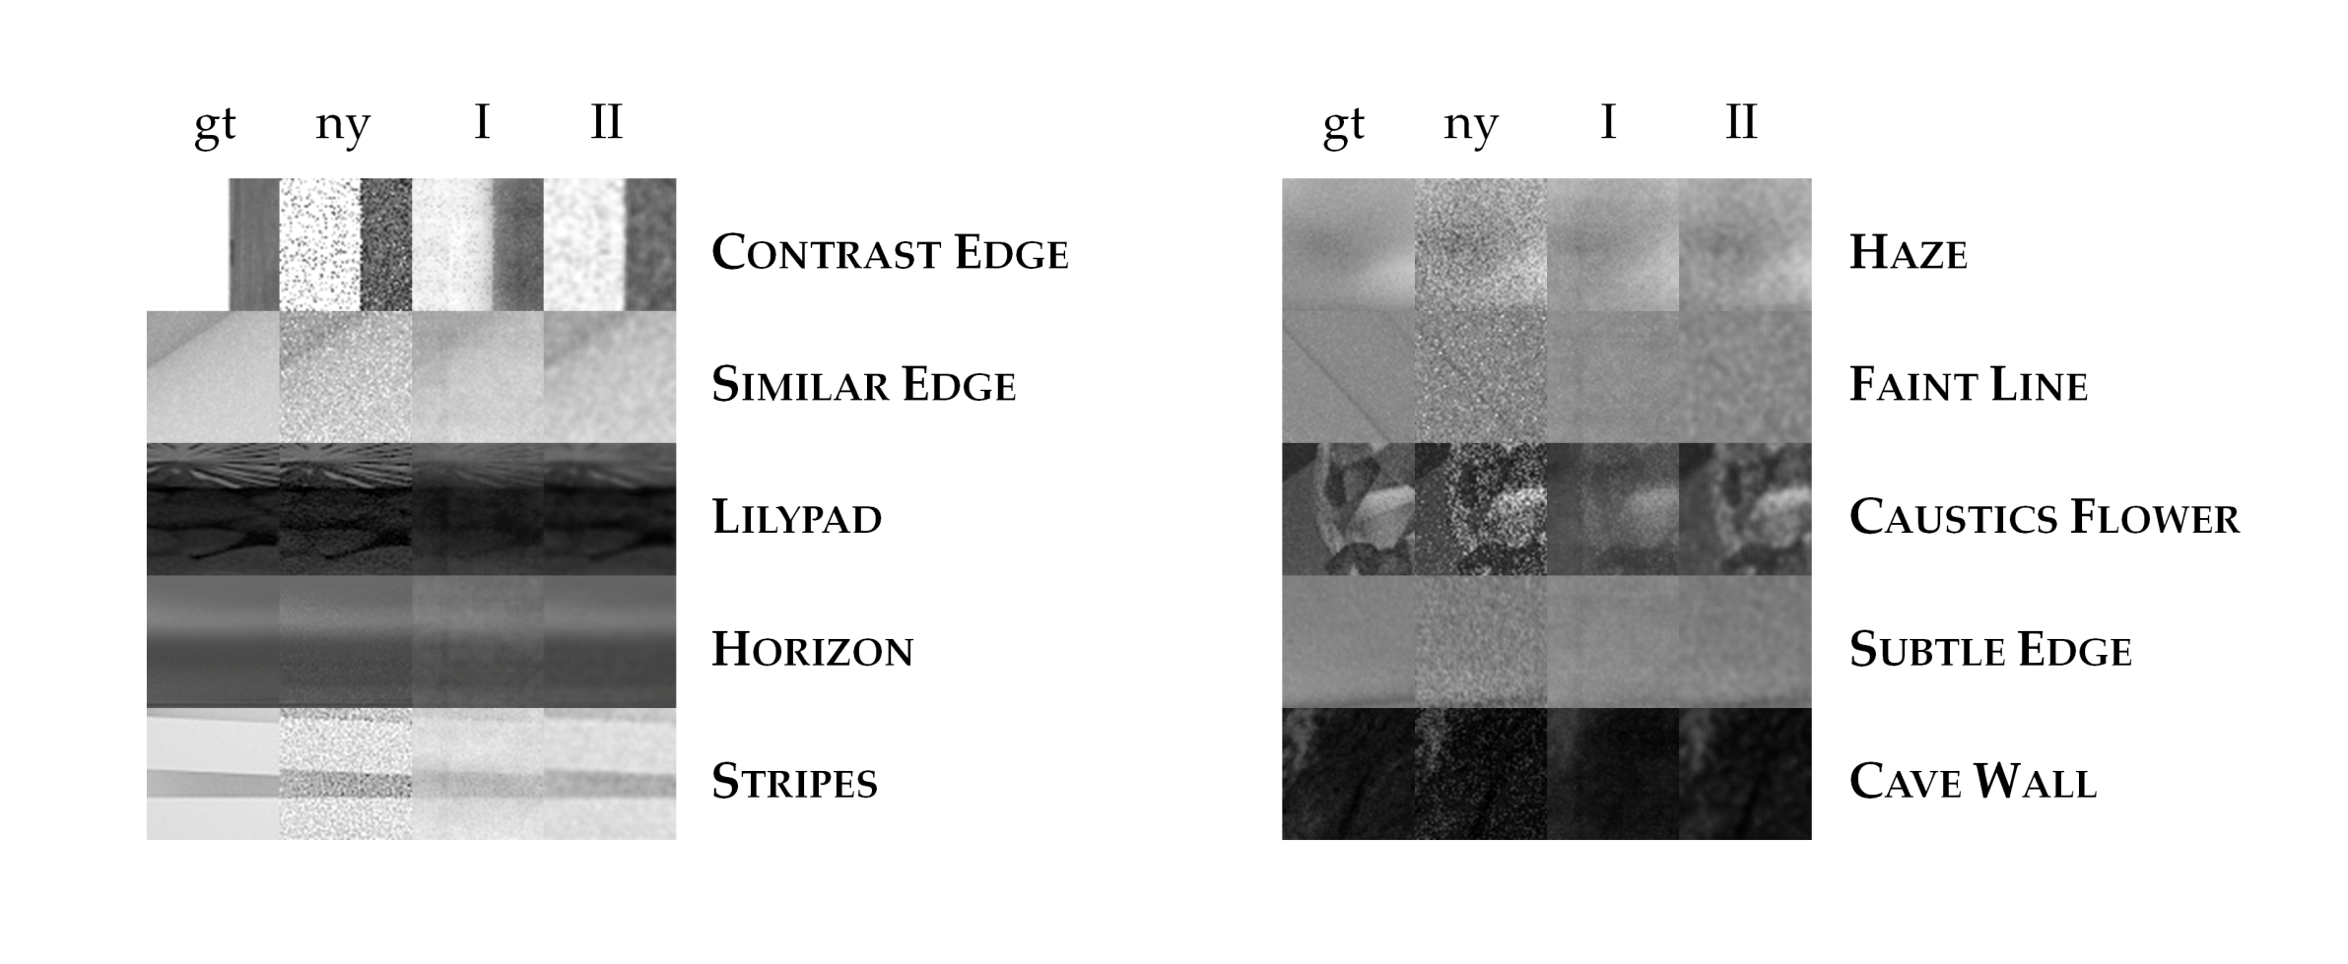

Slide 41
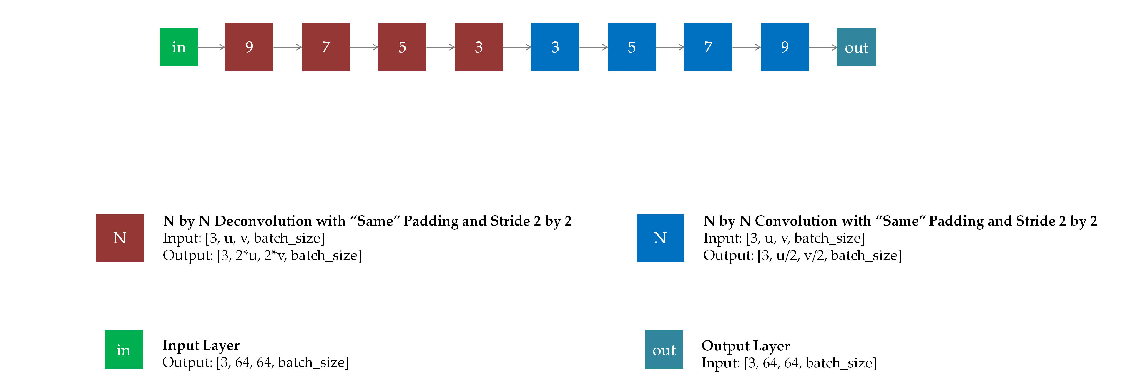

Slide 42
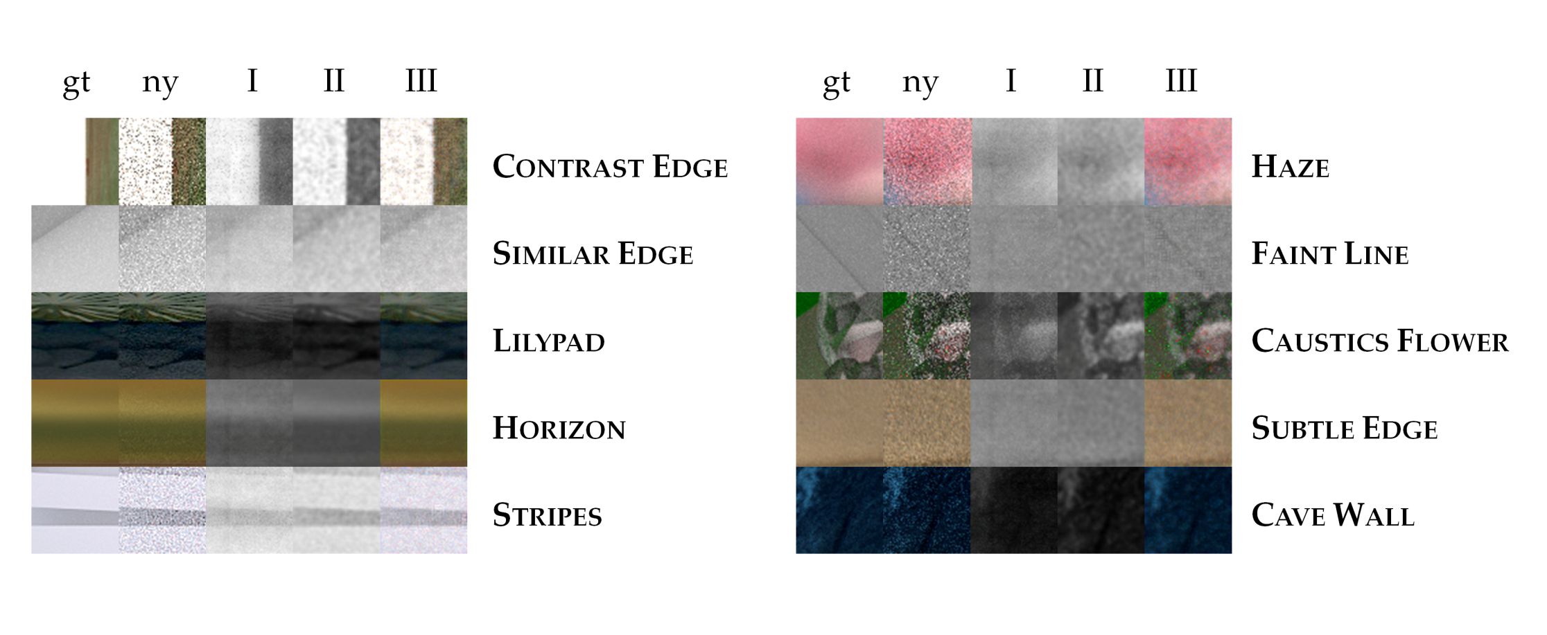

Slide 43
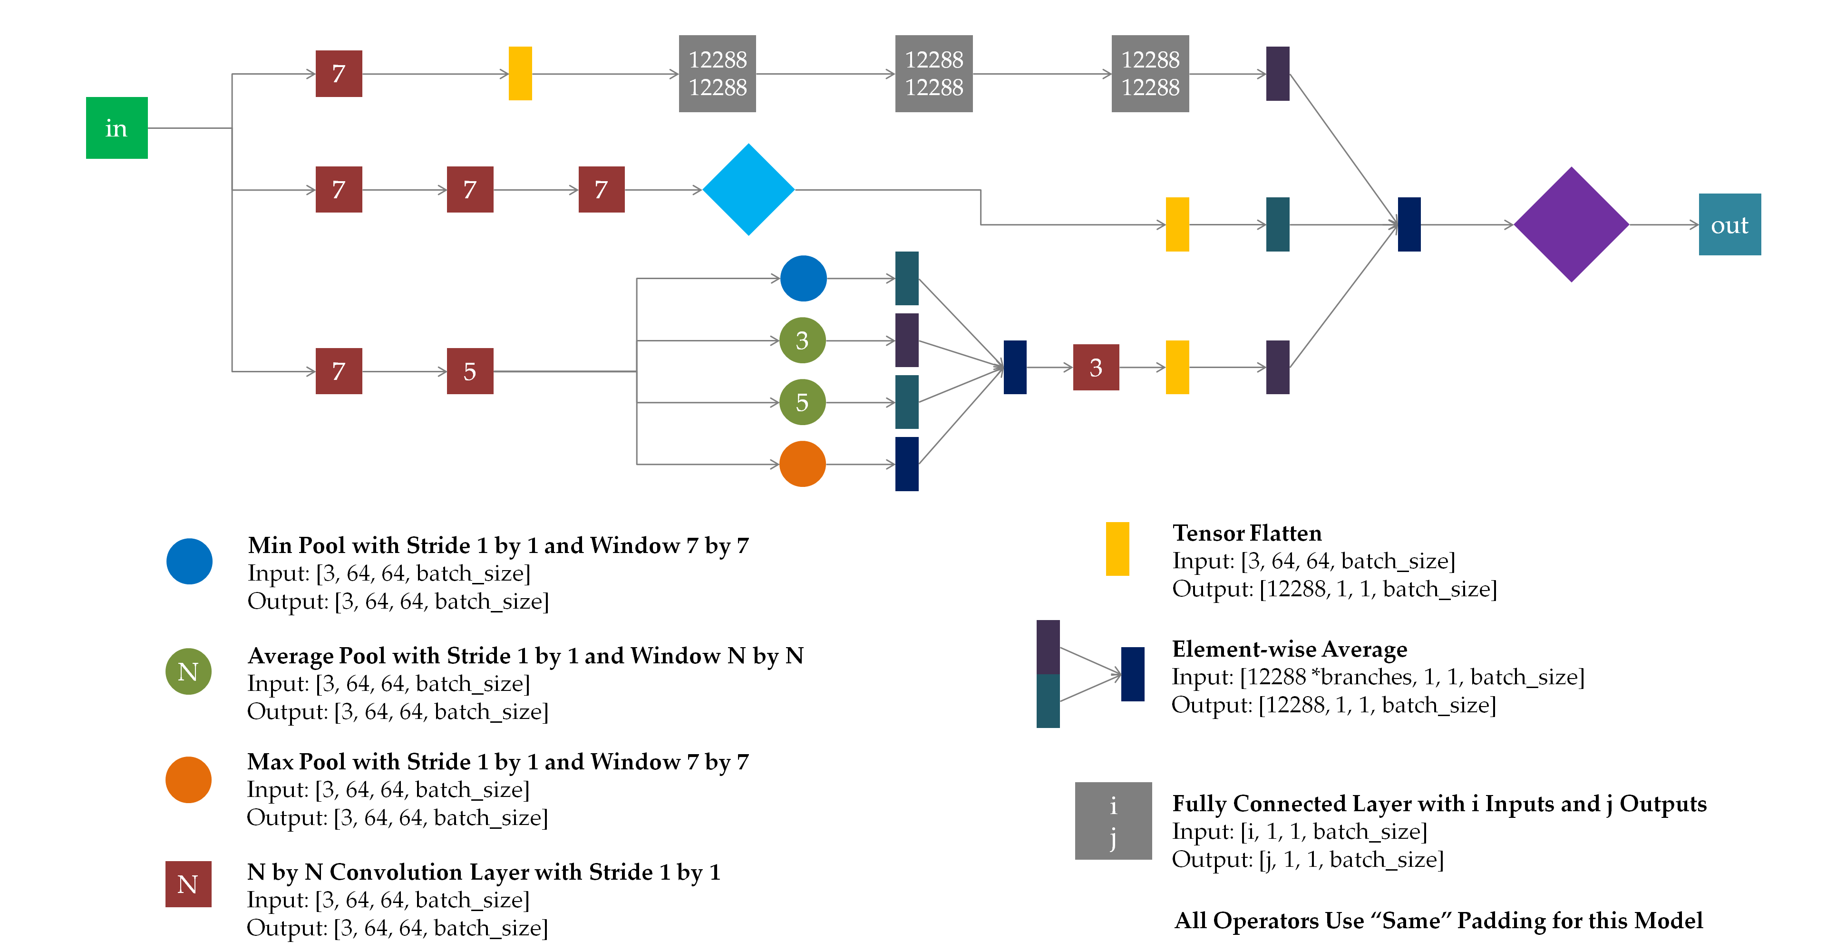

Slide 44
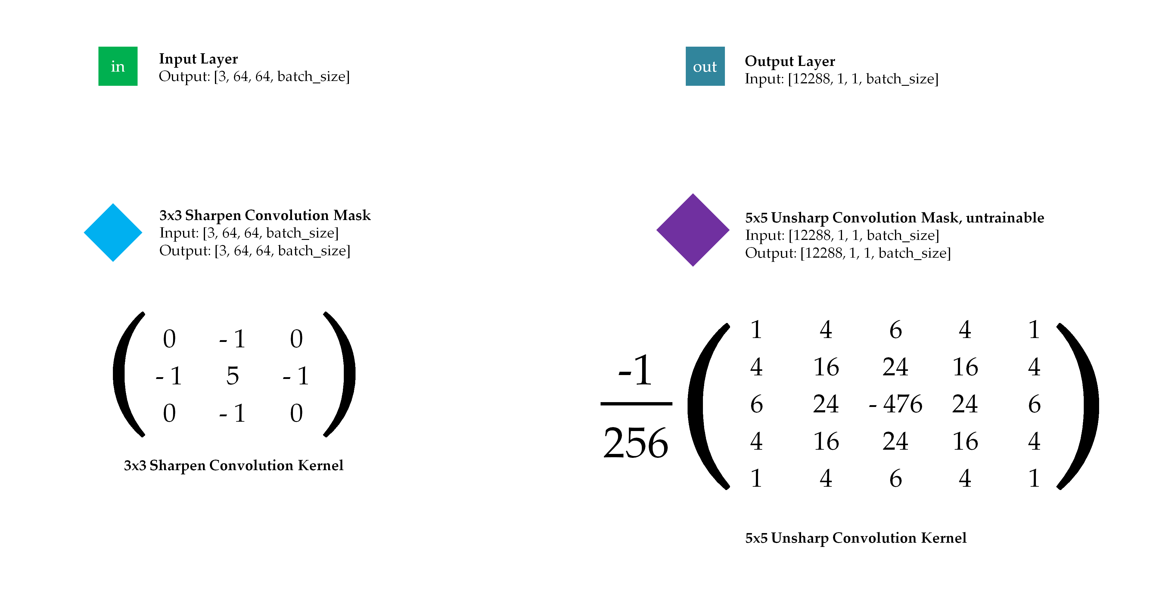

Slide 45
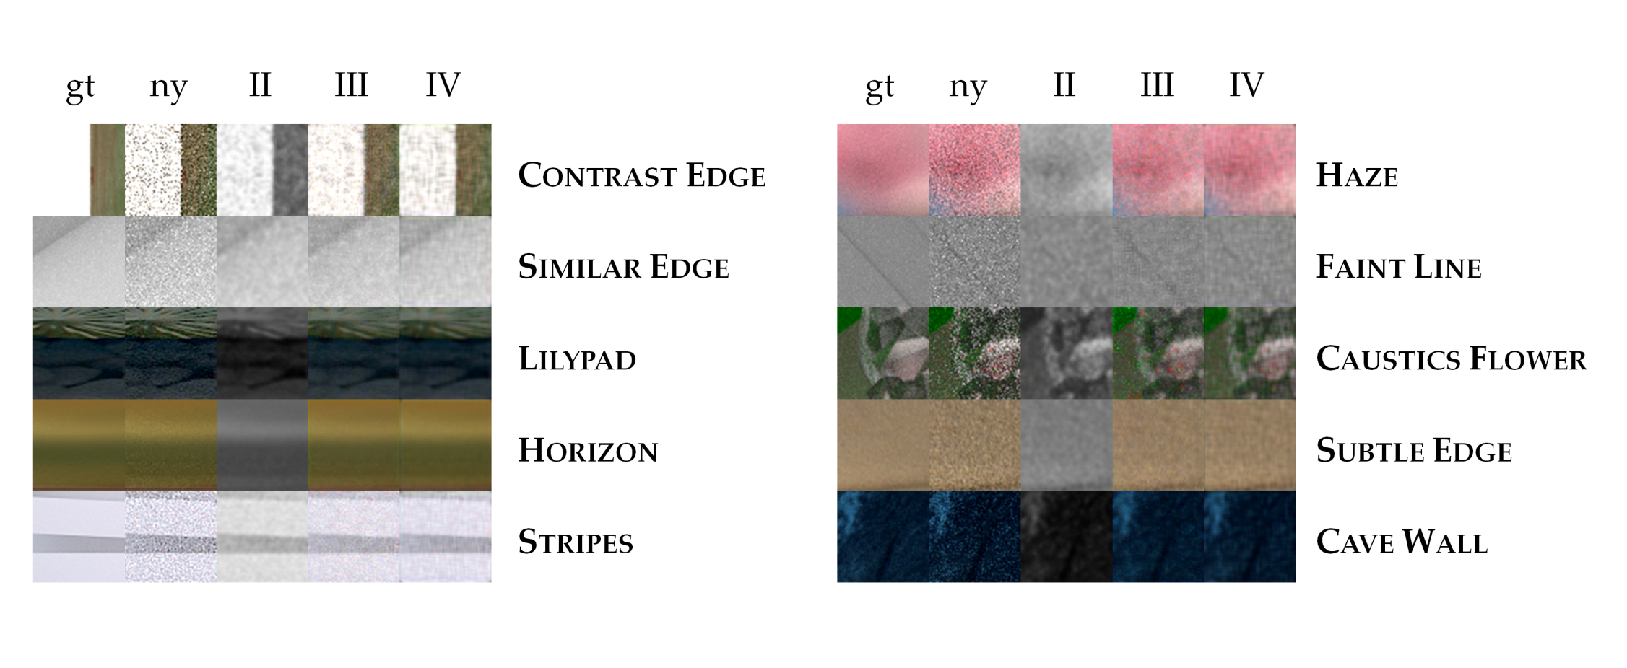

Slide 46
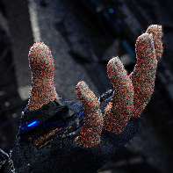
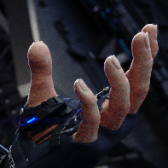
Neural Network
64
64
64
64

Slide 47
Central Pixel of Patch is Designated Output
Neural Network
31
1
1
31

Slide 48
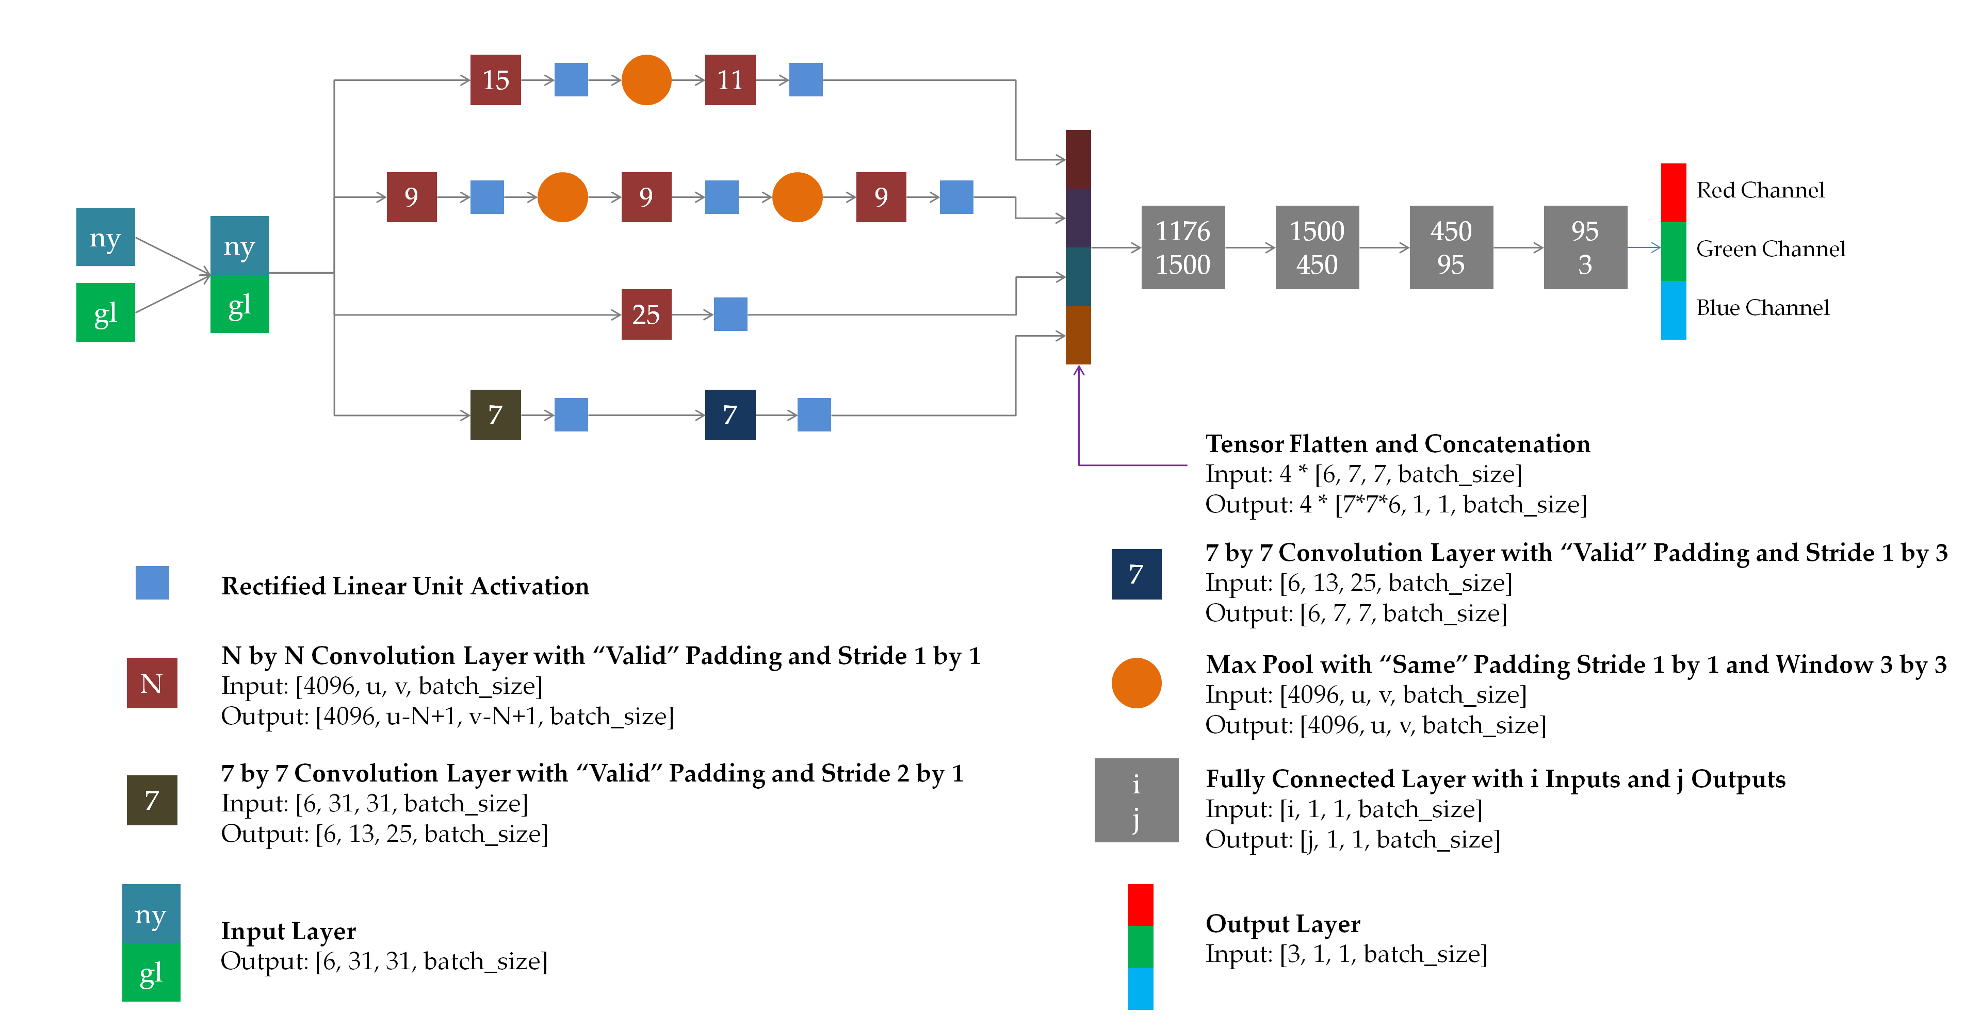

Slide 49
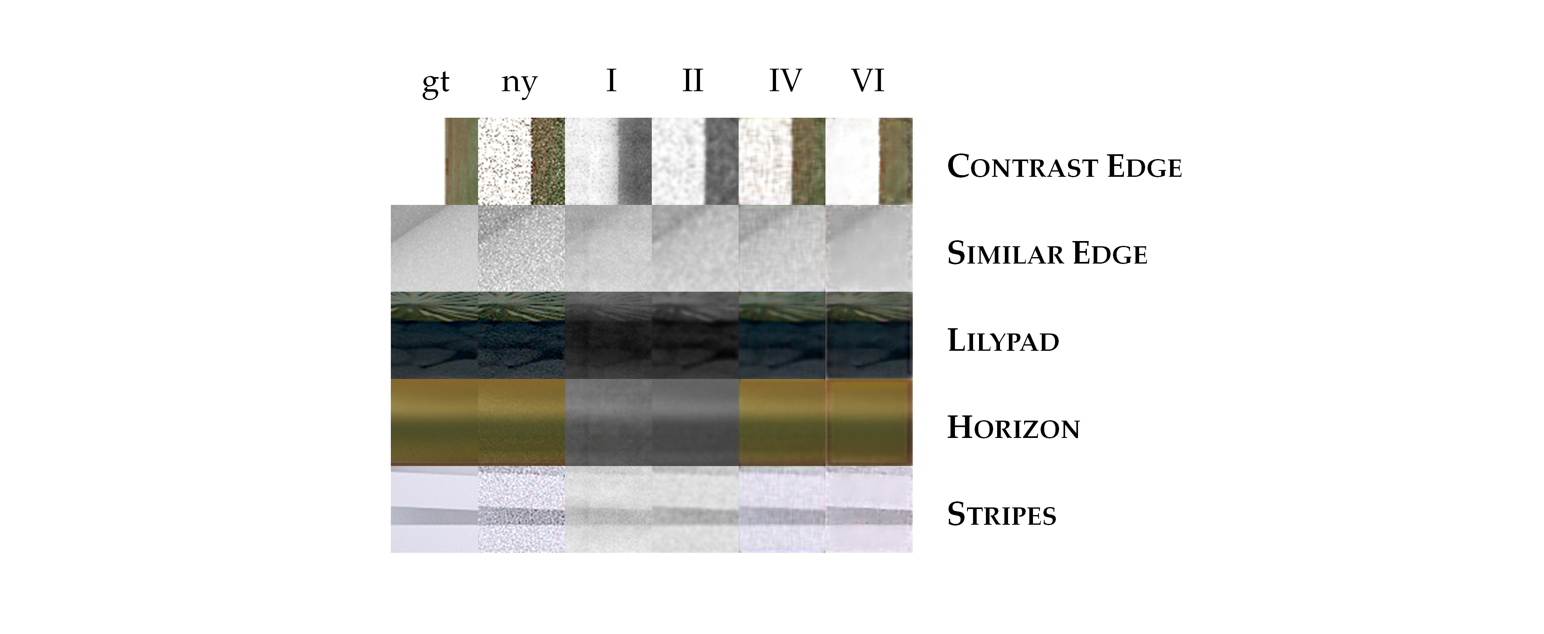

Slide 50
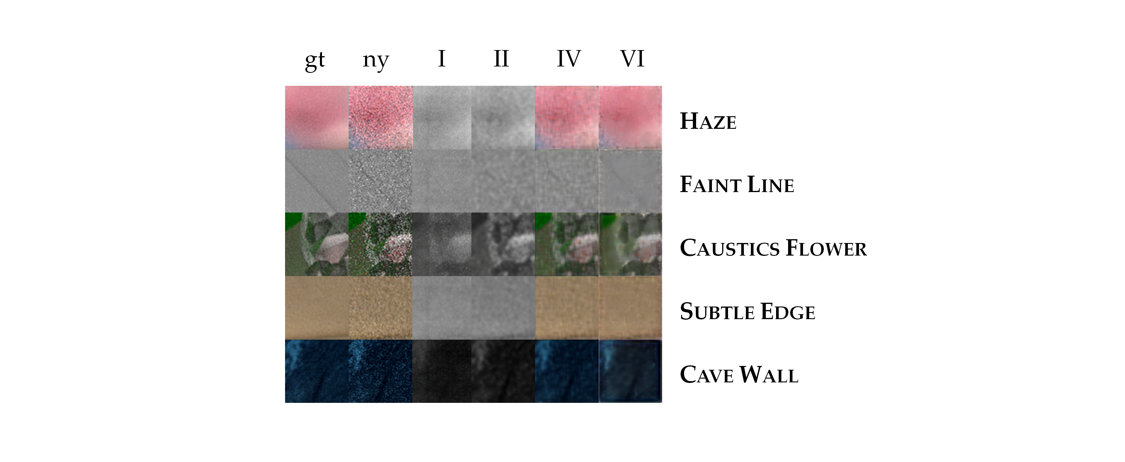

Slide 52
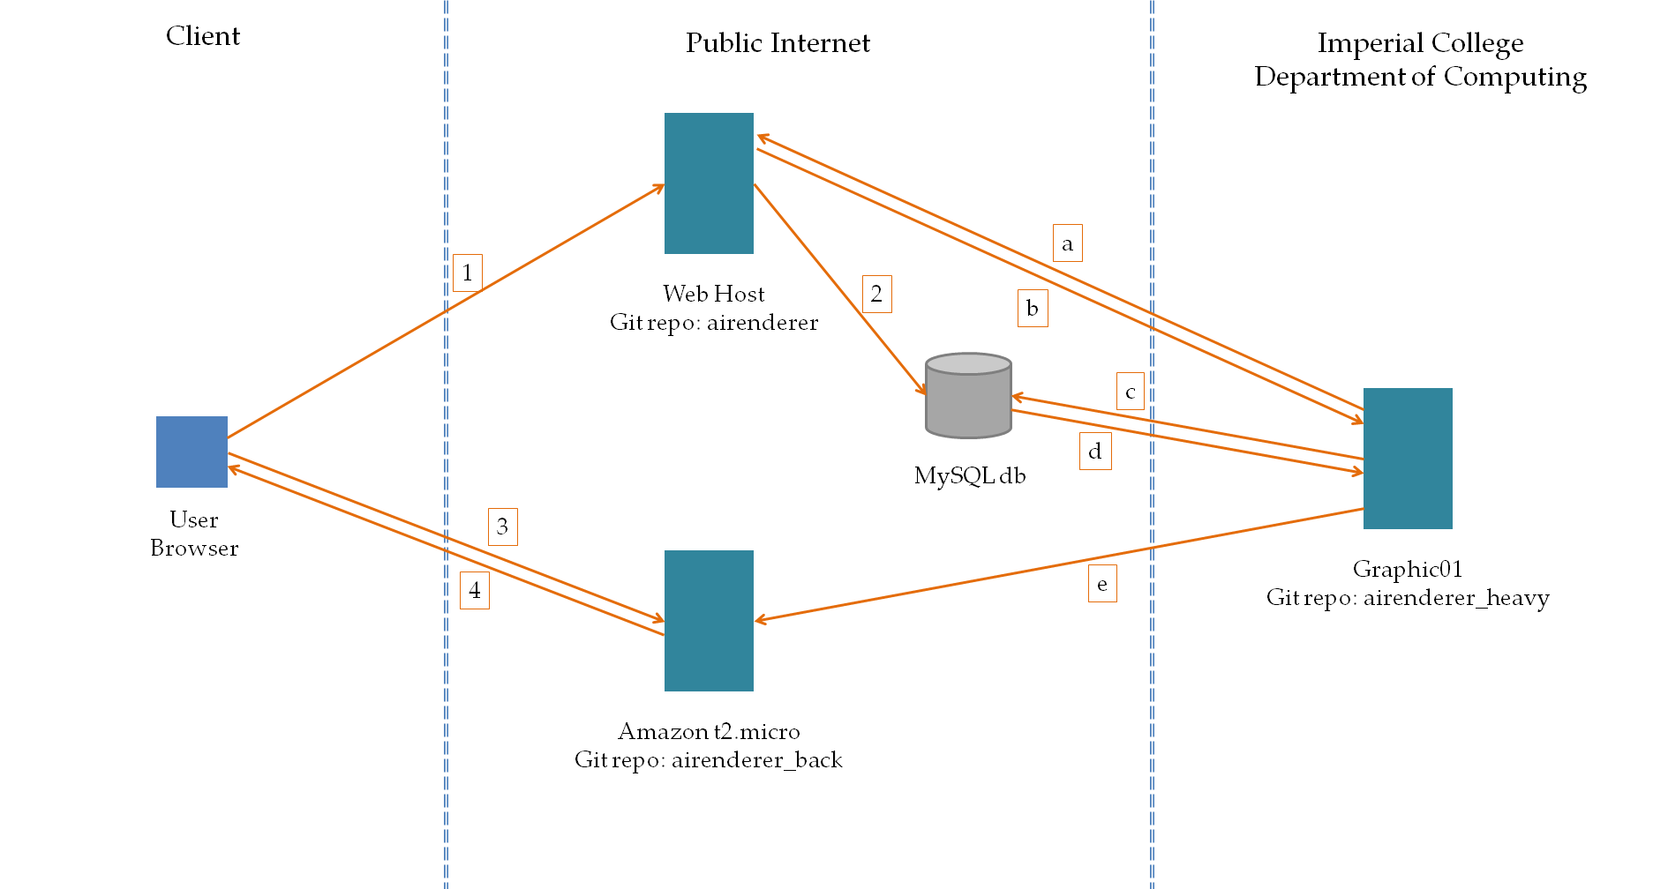

Slide 53
